Slide 1
Machine Learning

Slide 2
Content
What is AI and ML
What is SL, UL, RL
Regression and Classification
Linear regression
Classification
Naïve Bayes
Decision Tree
Random forest
SVM
KNN

Slide 3
1) What is AI & ML?
AI :- Artificial intelligence is the simulation of human intelligence processes by machines, especially computer systems
ML:- Machine learning (ML) is a type of artificial intelligence (AI) that allows software applications to become more accurate at predicting outcomes without being explicitly programmed to do so. Machine learning algorithms use historical data as input to predict new output values.

Slide 4
What is SL,USL,RL
Supervised Learning
The machine learns by using labeled data. Eg- Image detection, Population growth prediction.
Unsupervised Learning
The machine is trained on unlabeled data without any guidance. Eg- Customer segmentation, feature elicitation, targeted marketing, etc
Reinforcement Learning
An agent interacts with its environment by performing actions & learn from errors or rewards.

Slide 5
Regression and Classification
Regression :- Is used to predict continuous values. Eg- Predicting prices of a house given the features of house like size, price etc.
Classification :- Is used to categorizes a set of data into classes.Eg- yes or no ,true or false.

Slide 6
Linear Regression Algorithm
Linear regression is a statistical method that establishes a linear relationship between a dependent variable and independent variables. It uses a linear equation to predict the dependent variable based on the values of the independent variables, aiming to minimize the difference between observed and predicted values.

Slide 7
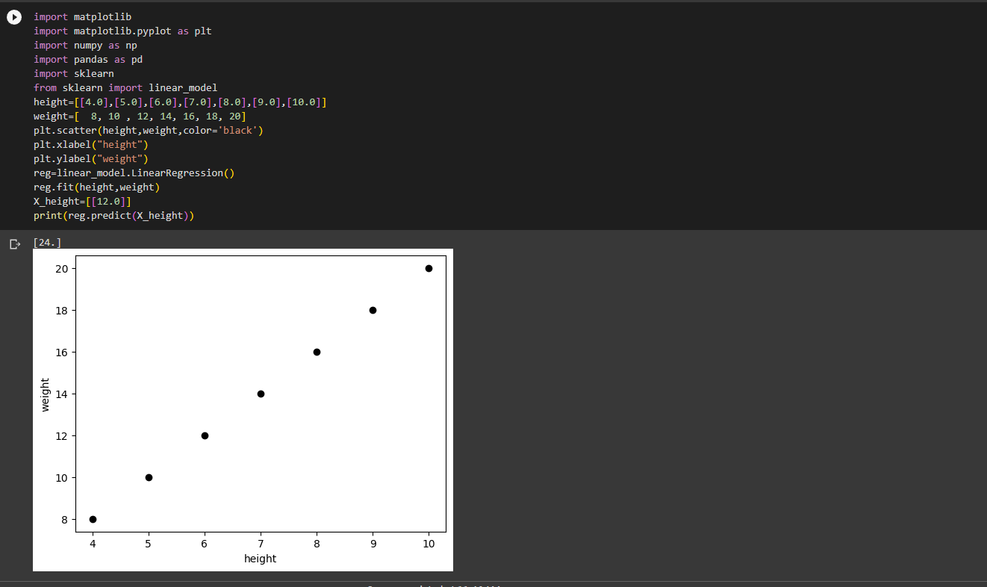

Slide 8
Classification
Classification is a machine learning technique that assigns predefined labels or categories to input data based on patterns and features. It involves training a model on labeled examples and then using it to predict the class of unseen data points based on learned patterns.

Slide 9
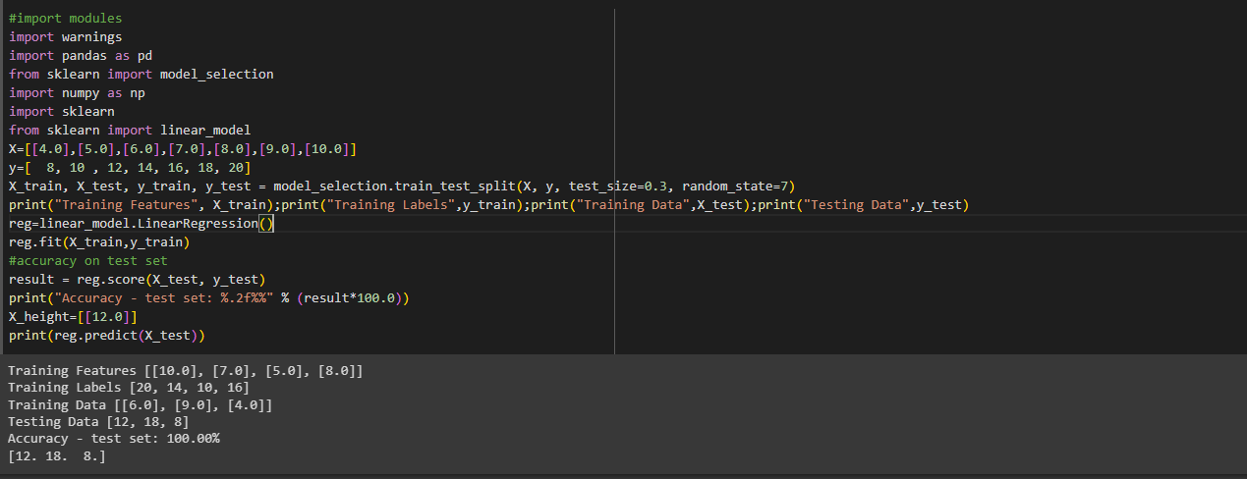

Slide 10
Naive Bayes
Naive Bayes is a probabilistic machine learning algorithm based on Bayes' theorem. It assumes that features are conditionally independent given the class label, making it "naive." It calculates the probability of a data point belonging to a certain class based on the probabilities of its features. Naive Bayes is commonly used for text classification and spam filtering tasks.

Slide 11
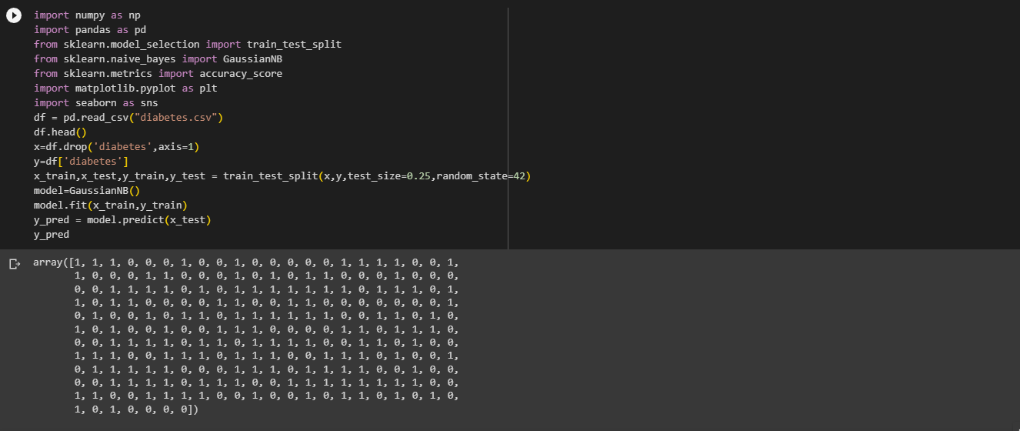

Slide 12
DECISION TREE
A decision tree is a machine learning algorithm that creates a tree-like model of decisions and their possible consequences. It partitions the input data based on features and recursively splits the data into subsets, optimizing for the most informative features to make predictions or decisions based on the data's characteristics.

Slide 13
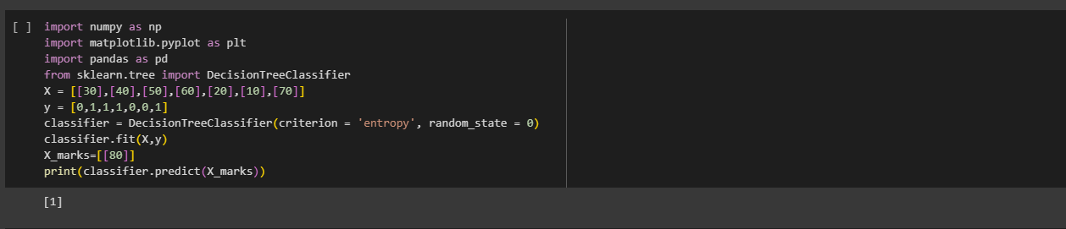

Slide 14
Random Forest
Random Forest is an ensemble learning method that combines multiple decision trees to make predictions. It creates a collection of decision trees, each trained on a randomly sampled subset of the training data and features. The final prediction is made by aggregating the predictions of individual trees, resulting in improved accuracy and robustness.

Slide 15
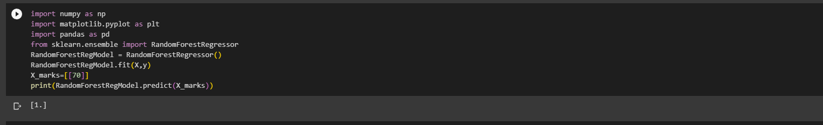

Slide 16
SVM
Support Vector Machine (SVM) is a supervised machine learning algorithm used for classification and regression tasks. It maps input data into a high-dimensional space and finds the optimal hyperplane that maximally separates different classes or predicts the target variable. SVM is effective for handling complex datasets and handling high-dimensional feature spaces.

Slide 17
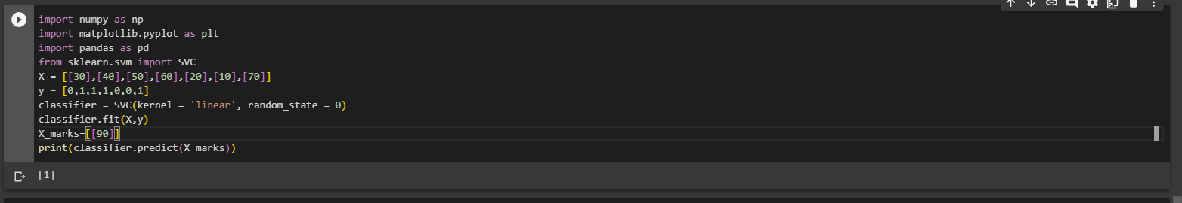

Slide 18
KNN
K-Nearest Neighbors (KNN) is a simple yet powerful supervised machine learning algorithm used for classification and regression. It assigns labels to data points based on the majority class of their nearest neighbors in the feature space. The value of k determines the number of neighbors considered for classification or regression.

Slide 19
